Slide 1


Egypt’s External Debt Analysis
Macroeconomic factors associated with debt dynamics, 1970–2024
R | World Bank WDI

Slide 2

Research Question
Which macroeconomic factors are associated with changes in Egypt’s external public debt?
01
GDP growth
02
inflation
03
Foreign direct investment
04
Export
05
Current Account

Slide 3
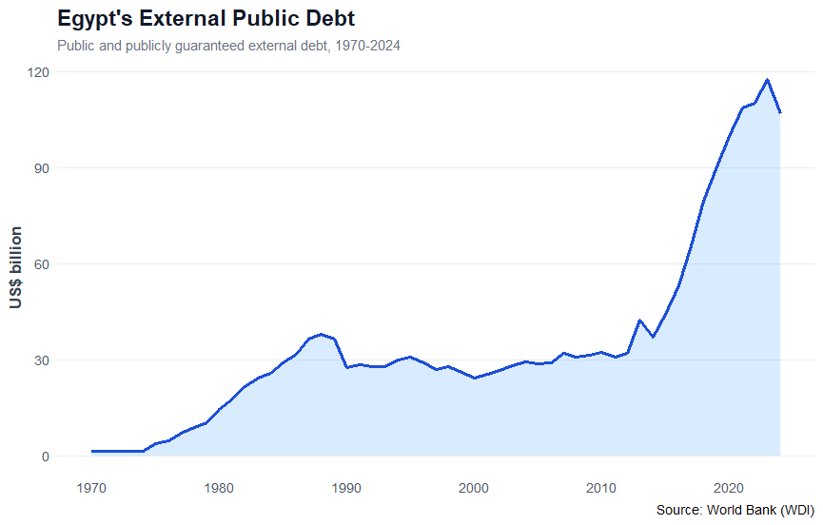
Debt Trend 1970-2024
Egypt’s external public debt followed different historical phases.
After a relatively stable period, debt accelerated sharply from the mid-2010s and reached its highest levels near the end of the sample.

Slide 4
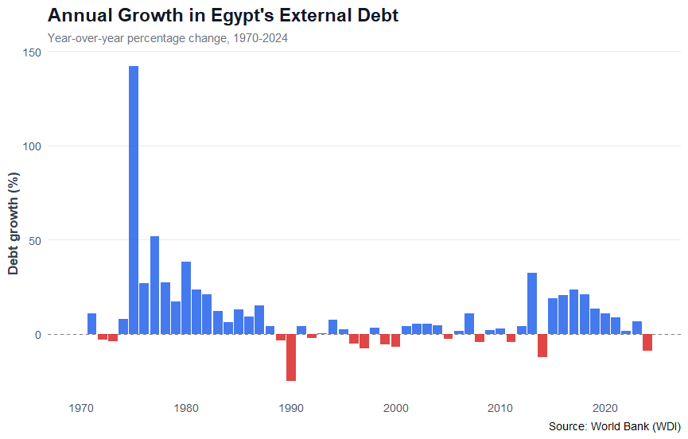
Annual Growth & Volatility
Annual debt growth was highly volatile. Several years recorded sharp increases, while others experienced declines.
Debt accumulation did not follow a constant pattern.

Slide 5
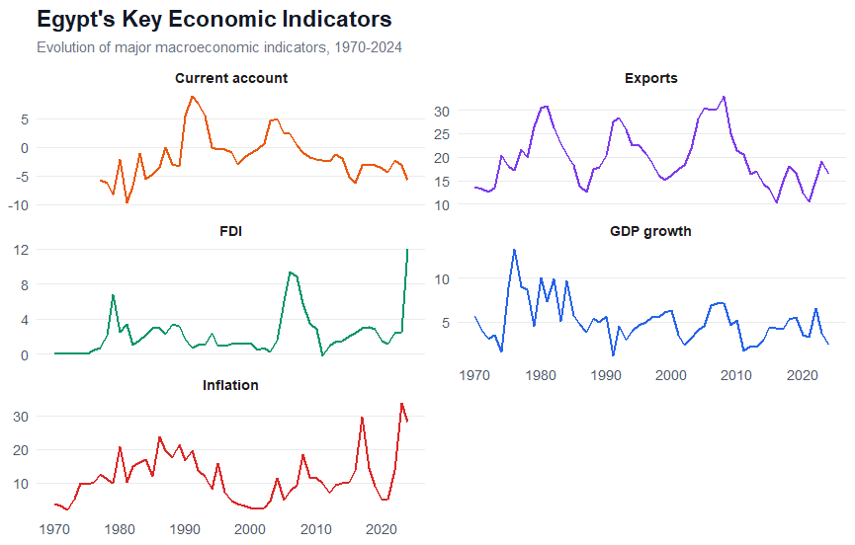
Macroeconomic Context
Egypt’s macroeconomic environment changed substantially across the period. GDP growth, inflation, FDI, exports and the current account all experienced periods of significant variation.
Why it matters
Debt dynamics should be interpreted within the broader macroeconomic environment.

Slide 6
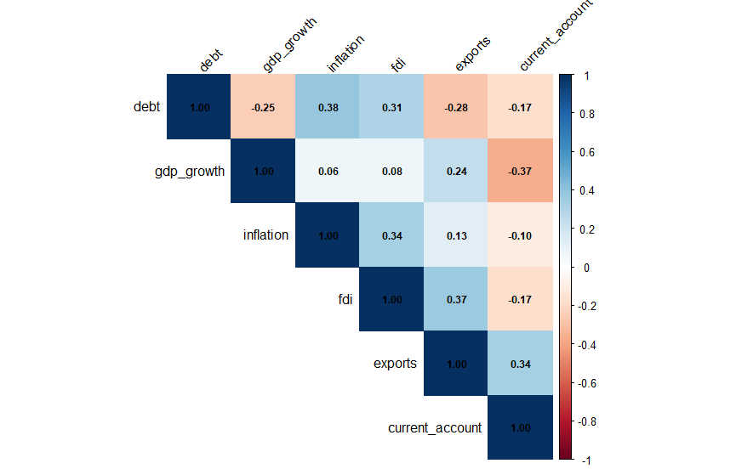
Correlation & Scatter
Pairwise correlations were generally weak to moderate.
Inflation and FDI showed positive correlations with external debt, while GDP growth, exports and the current account showed negative correlations.
Correlation ≠ causation

Slide 7
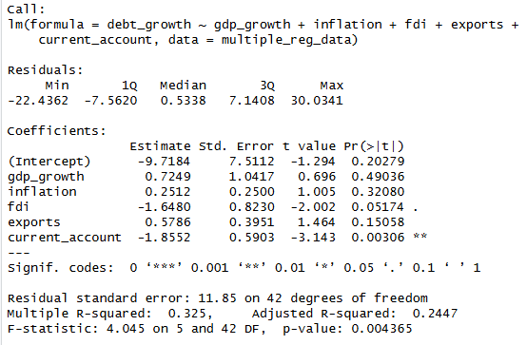
What Remains Significant After Controlling for Other Factors?
Multiple Regression | Debt Growth as the Dependent Variable
Key Findings
The model is statistically significant overall (p = 0.004) and explains around 32.5% of the variation in annual external debt growth.
The current account balance is the strongest statistically significant factor (β = -1.86, p = 0.003).
FDI also shows a negative association (β = -1.65), but its significance is borderline (p = 0.052).
A 1 percentage-point improvement in the current account balance is associated with approximately 1.86 percentage points lower annual debt growth, holding the other variables constant.

Slide 8


Thank You
Interested in the full analysis?
The complete project, including the R code, methodology, visualizations, and README documentation, is available on GitHub.
View Full Project on GitHub
Mostafa Soliman Donia
Data & Statistical Analyst
linkedin profile
Github profile

